Slide 1


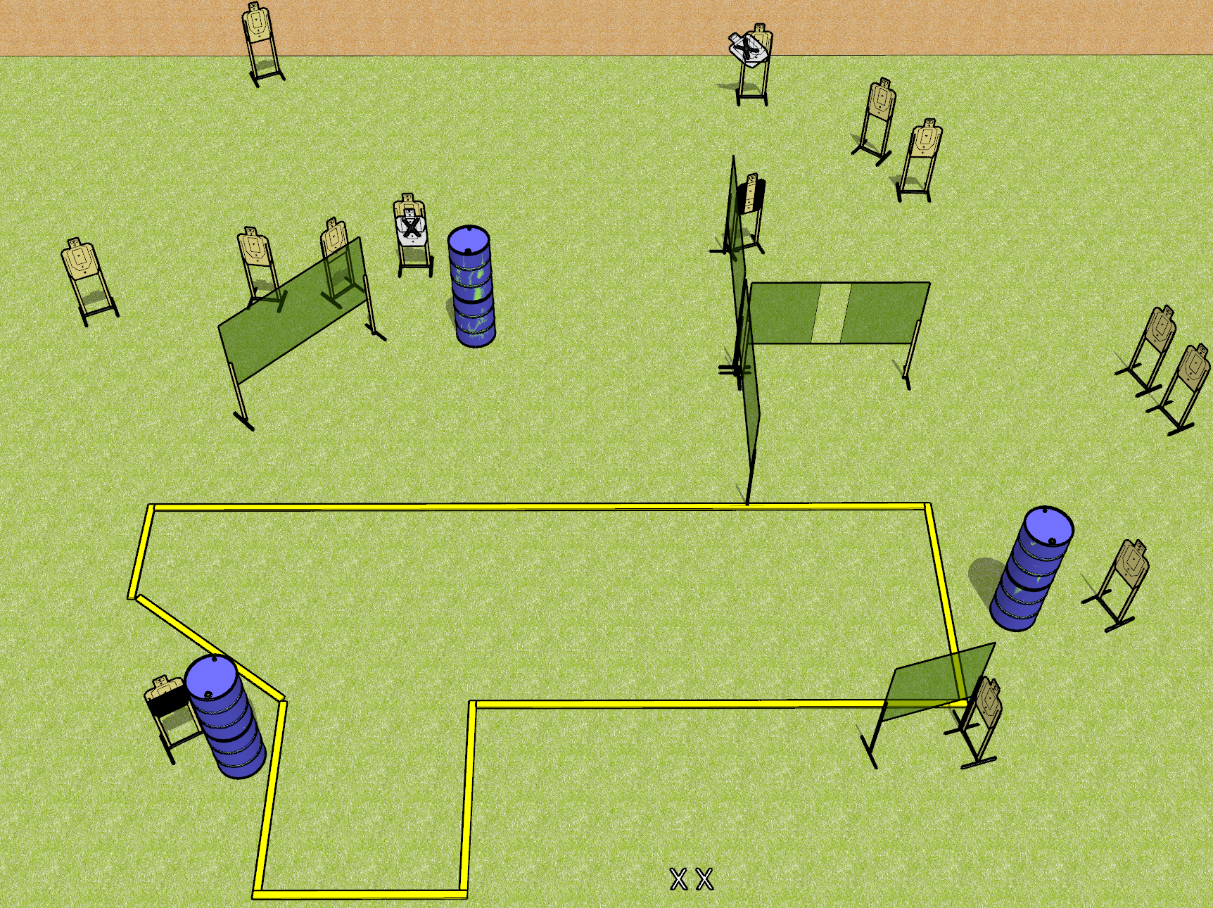
 | Dothan Gun Club – USPSA Match Raygun Course Designer : Drew Coleman
Round Count 28 rounds 14 USPSA targets
Equipment List 11 wall feet 1 action target, 1 headshot, 1 Tuxedo Notes: Barrel in the center is to block shoot through. Upper right – the open target that’s angled inwards should be available from the far left corner of the stage. Consider moving X’s some place more annoying.

Slide 2
Raygun
Written Stage Briefing
Raygun is a 28 round, 140 point, Comstock field course. There are 14 USPSA targets. The best 2 hits on paper will score, and steel must fall to score. The start signal is audible.
Handgun start position is both feet on X’s, wrists below belt. Handgun is loaded and holstered.
PCC start position is both feet on X’s. Loaded carbine is held with both hands, safety on.
On start signal, engage targets as they become available from within the shooting area.

